Slide 1


Amazon Sales Analysis Presentation

Slide 2



Introduction
Sales management is the process of planning, implementing, and controlling the sales activities of a business organization to achieve its sales objectives. Sales management involves various tasks such as setting sales goals, designing sales strategies, recruiting and training sales staff, supervising and motivating sales teams, evaluating sales performance, and providing feedback and coaching to sales personnel.

Slide 3

The main purpose of sales management is to ensure that the sales activities of a business are aligned with its overall goals and objectives, and that the sales resources are utilized effectively and efficiently to generate maximum sales revenue and profit.
Sales management also helps to create and maintain customer relationships, enhance customer satisfaction and loyalty, and increase market share and competitive advantage.

Slide 4

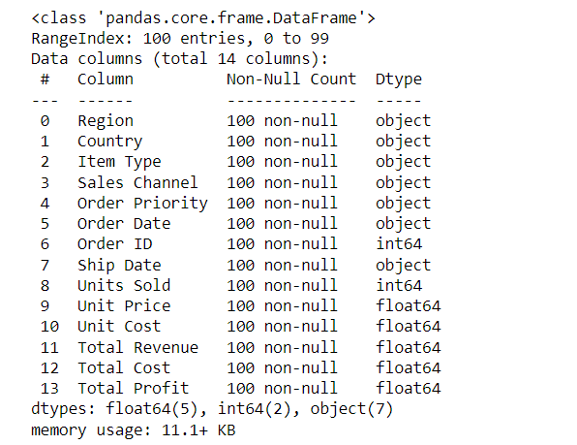
Details Of Data

Slide 5
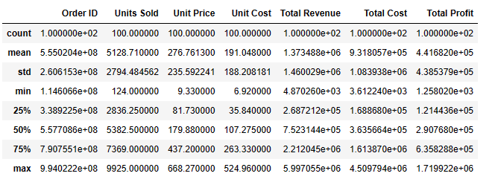
Description Of Data

Slide 6

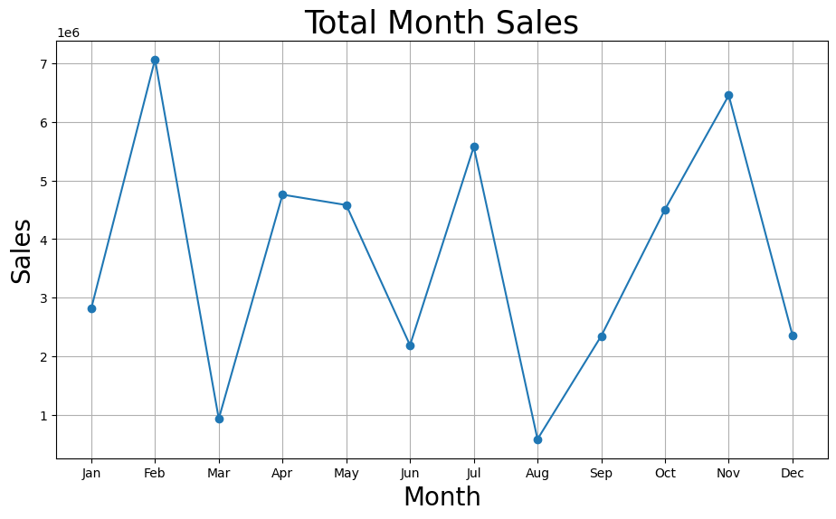
Monthly Sales
In the Graph, we can see that sales peak during holiday season- (February, July, November)
Action Plan: Plan targeted promotions during peak seasons and consider summer-specific campaigns.

Slide 7
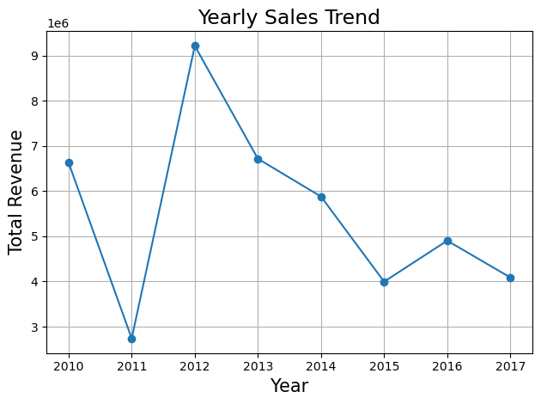
Yearly Sales
In the Graph, we can see that sales peaked in 2012
Action Plan: We can do further research on what factors led to this surge in 2012

Slide 8
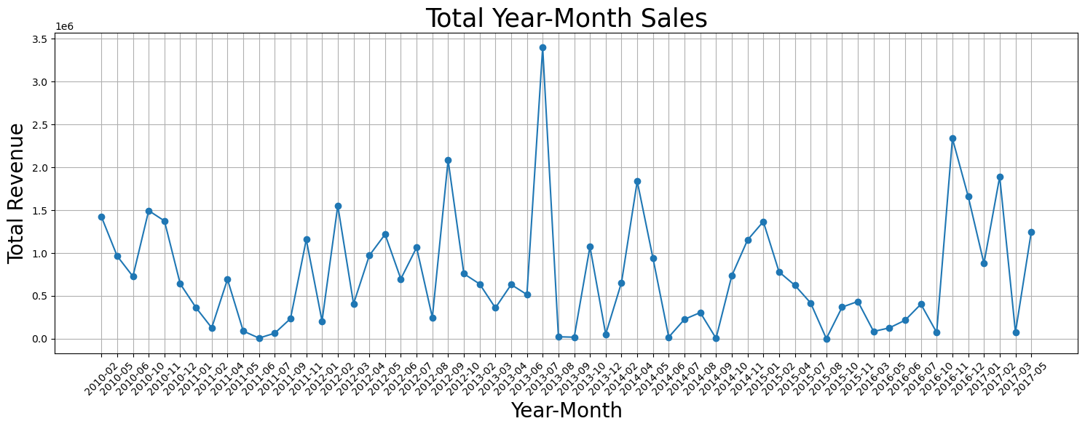
Yearl Monthly Sales
In the Graph, we can see that the greatest number of sales happend in July of 2013

Slide 9
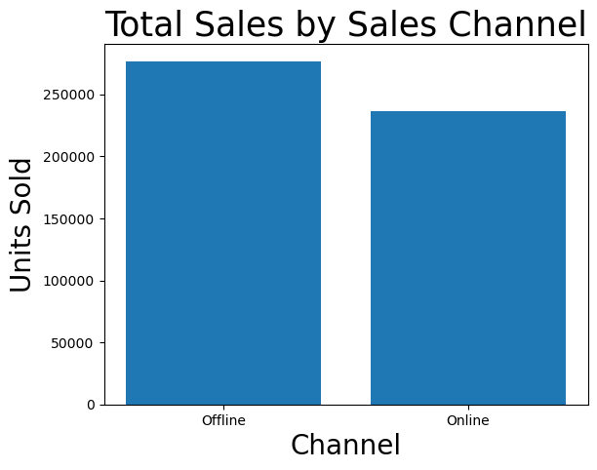
In the Graph, we can see that we sell most number ofunits via our offline channels.
We can concentrate on that and better our offline approaches.

